Slide 1
Deadlocks
Dr. Amar Singh
Associate Professor, SCA
Operating System Concepts

Slide 2
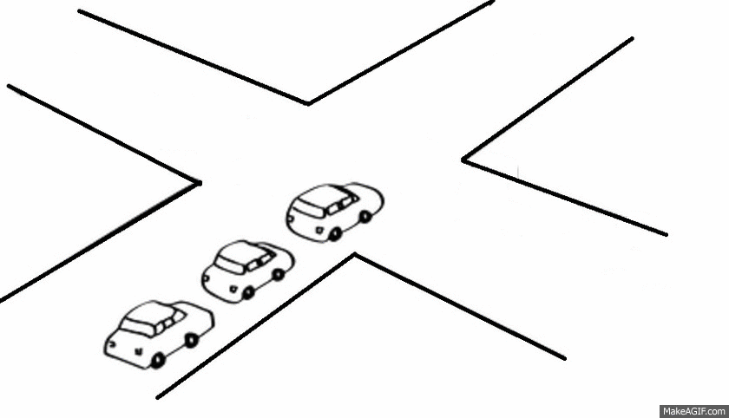
Operating System Concepts

Slide 3
Deadlock
Deadlock is a situation where a set of processes are blocked because each process is holding a resource and waiting for another resource acquired by some other process.
Operating System Concepts

Slide 4
Bridge Crossing Example
Traffic only in one direction.
Each section of a bridge can be viewed as a resource.
If a deadlock occurs, it can be resolved if one car backs up (preempt resources and rollback).
Several cars may have to be backed up if a deadlock occurs.
Starvation is possible.
Operating System Concepts

Slide 5

Example: too little memory
Two processes each demand 1.5 Gb of memory on a machine with only 2 Gb (and no virtual memory). The operating system kindly gives each 1 Gb exactly.
Neither process can make progress until the other gives up some of its memory.
Operating System Concepts

Slide 6
The Deadlock Problem
A set of blocked processes each holding a resource and waiting to acquire a resource held by another process in the set.
Example
  System has 2 tape drives.
  P₁ and P₂ each hold one tape drive and each needs another one.
Example
  semaphores A and B, initialized to 1
        P₀ P₁
        wait (A); wait(B)
        wait (B); wait(A)
Operating System Concepts

Slide 7
System Table
A system table records whether each resource is free or allocated;
For each resource that is allocated, the table also records the process to which it is allocated.
If a process requests a resource that is currently allocated to another process, it can be added to a queue of processes waiting for this resource
Operating System Concepts

Slide 8
Deadlock Characterization
Deadlock can arise if four conditions hold simultaneously.
Mutual exclusion: only one process at a time can use a resource.
Hold and wait: a process holding at least one resource is waiting to acquire additional resources held by other processes.
No preemption: a resource can be released only voluntarily by the process holding it, after that process has completed its task.
Circular wait: there exists a set {P₀, P₁, …, P_{n}} of waiting processes such that P₀ is waiting for a resource that is held by P₁, P₁ is waiting for a resource that is held by P₂, …, P_{n–1} is waiting for a resource that is held by P_{n}, and P_{n} is waiting for a resource that is held by P₀.
Operating System Concepts

Slide 9
Methods for Handling Deadlocks
Never allow the four conditions in the system. (PREVENTION)
Ensure that the system will never enter a deadlock state. (AVOIDANCE)
Allow the system to enter a deadlock state and then recover. (DETECTION AND RECOVERY)
Ignore the problem and pretend that deadlocks never occur in the system; used by most operating systems, including UNIX.
Operating System Concepts

Slide 10
System Model
Resource types R₁, R₂, . . ., R_{m}
    CPU cycles, memory space, I/O devices
Each resource type R_{i} has W_{i} instances.
Each process utilizes a resource as follows:
  request
  use
  release
Operating System Concepts

Slide 11
Resource-Allocation Graph
A set of vertices V and a set of edges E.
V is partitioned into two types:
  P = {P₁, P₂, …, P_{n}}, the set consisting of all the processes in the system.
  R = {R₁, R₂, …, R_{m}}, the set consisting of all resource types in the system.
request edge – directed edge P₁ → R_{j}
assignment edge – directed edge R_{j} → P_{i}
Operating System Concepts

Slide 12
Resource-Allocation Graph (Cont.)
Process
Resource Type with 4 instances
P_{i} requests instance of R_{j}
P_{i} is holding an instance of R_{j}
P_{i}
R_{j}
P_{i}
R_{j}
Operating System Concepts

Slide 13

Example of a Resource Allocation Graph
Operating System Concepts

Slide 14

Resource Allocation Graph With A Deadlock
Operating System Concepts

Slide 15

Resource Allocation Graph With A Cycle But No Deadlock
Operating System Concepts

Slide 16
Basic Facts
If graph contains no cycles ⇒ no deadlock.
If graph contains a cycle ⇒
  if only one instance per resource type, then deadlock.
  if several instances per resource type, possibility of deadlock.
Operating System Concepts

Slide 17
How to prepare the resource allocation graph?
Operating System Concepts

Slide 18
Example
Lets at any point of time, there are 3 process(P1,P2,P3) are running with resources (R1(1), R2(1), R3(2)).
Prepare the resource allocation graph with the following information
Process | P1 | P2 | P3
RESOURCE REQUEST | R1 | R1 | R2
RESOURCE ASSIGNED | P3 | P1 | P3, P2
Operating System Concepts

Slide 19
P3
R1
R2
R3
P1
P2
Operating System Concepts

Slide 20
Exercise
Lets at any point of time, there are 2 process(P1,P2) are running with resources (R1(1), R2(1)).
Prepare the resource allocation graph with the following information
Process | P1 | P2
RESOURCE REQUEST | R2 | R1
RESOURCE ASSIGNED | R1 | R2
Operating System Concepts

Slide 21
Deadlock Prevention
Restrain the ways request can be made.
Mutual Exclusion – not required for sharable resources; must hold for non sharable resources.
Hold and Wait – must guarantee that whenever a process requests a resource, it does not hold any other resources.
  Require process to request and be allocated all its resources before it begins execution, or allow process to request resources only when the process has nothing.
  An alternative method is that a process may request some resources and use them. Before it can request any additional resources, however, it must release all the resources that it is currently allocated.
  Low resource utilization; starvation possible.
Operating System Concepts

Slide 22
Deadlock Prevention (Cont.)
No Preemption –
  If a process that is holding some resources requests another resource that cannot be immediately allocated to it, then all resources currently being held are released.
  Preempted resources are added to the list of resources for which the process is waiting.
  Process will be restarted only when it can regain its old resources, as well as the new ones that it is requesting.
Circular Wait – impose a total ordering of all resource types, and require that each process requests resources in an increasing order of enumeration.
Operating System Concepts

Slide 23
Deadlock Avoidance
Requires that the system has some additional a priori information
available.
Simplest and most useful model requires that each process declare the maximum number of resources of each type that it may need.
The deadlock-avoidance algorithm dynamically examines the resource-allocation state to ensure that there can never be a circular-wait condition.
Resource-allocation state is defined by the number of available and allocated resources, and the maximum demands of the processes.
Operating System Concepts

Slide 24

Safe, Unsafe , Deadlock State
Operating System Concepts

Slide 25
Basic Facts
If a system is in safe state ⇒ no deadlocks.
If a system is in unsafe state ⇒ possibility of deadlock.
Avoidance ⇒ ensure that a system will never enter an unsafe state.
Operating System Concepts

Slide 26
Safe State
When a process requests an available resource, system must decide if immediate allocation leaves the system in a safe state.
System is in safe state if there exists a safe sequence of all processes.
Sequence <P₁, P₂, …, P_{n}> is safe if for each P_{i}, the resources that Pi can still request can be satisfied by currently available resources + resources held by all the P_{j}, with j<I.
  If P_{i} resource needs are not immediately available, then P_{i} can wait until all P_{j} have finished.
  When P_{j} is finished, P_{i} can obtain needed resources, execute, return allocated resources, and terminate.
  When P_{i} terminates, P_{i+1} can obtain its needed resources, and so on.
Operating System Concepts

Slide 27
Example: System with 12 Magnetic Tape Drives
Process | Maximum Needs | Allocated
P0 | 10 | 5
P1 | 4 | 2
P2 | 9 | 2
Safe State: <P1, P0, P2>
Unsafe State: if at time t₁, one more tape drive is allocated to p₂.
Operating System Concepts

Slide 28
Exercise: System with 12 Magnetic Tape Drives
Process | Maximum Needs | Allocated | Needed
P0 | 4 | 3 | 1
P1 | 8 | 4 | 4
P2 | 12 | 4 | 8
Safe State: ?
Operating System Concepts

Slide 29
Resource-Allocation Graph Algorithm
Claim edge P_{i} → R_{j} indicated that process P_{j} may request resource R_{j}; represented by a dashed line.
Claim edge converts to request edge when a process requests a resource.
When a resource is released by a process, assignment edge reconverts to a claim edge.
Resources must be claimed a priori in the system.
Operating System Concepts

Slide 30

Resource-Allocation Graph For Deadlock Avoidance
Operating System Concepts

Slide 31

Unsafe State In Resource-Allocation Graph
Operating System Concepts

Slide 32
Banker’s Algorithm
Multiple instances.
Each process must a priori claim maximum use.
When a process requests a resource it may have to wait.
When a process gets all its resources it must return them in a finite amount of time.
Operating System Concepts

Slide 33
Data Structures for the Banker’s Algorithm
Let n = number of processes, and m = number of resources types.
Available: Vector of length m. If available [j] = k, there are k instances of resource type R_{j} available.
Max: n x m matrix. If Max [i,j] = k, then process P_{i} may request at most k instances of resource type R_{j}.
Allocation: n x m matrix. If Allocation[i,j] = k then P_{i} is currently allocated k instances of R_{j.}
Need: n x m matrix. If Need[i,j] = k, then P_{i} may need k more instances of R_{j} to complete its task.
    Need [i,j] = Max[i,j] – Allocation [i,j].
Operating System Concepts

Slide 34
Safety Algorithm
1. Let Work and Finish be vectors of length m and n, respectively. Initialize:
      Work = Available
      Finish [i] = false for i - 1,3, …, n.
2. Find an i such that both:
  (a) Finish [i] = false
  (b) Need_{i} ≤ Work
  If no such i exists, go to step 4.
3. Work = Work + Allocation_{i}
Finish[i] = true
go to step 2.
4. If Finish [i] == true for all i, then the system is in a safe state.
Operating System Concepts

Slide 35
Resource-Request Algorithm for Process P_{i}
Request = request vector for process P_{i}. If Request_{i} [j] = k then process P_{i} wants k instances of resource type R_{j.}
  1. If Request_{i} ≤ Need_{i} go to step 2. Otherwise, raise error condition, since process has exceeded its maximum claim.
  2. If Request_{i} ≤ Available, go to step 3. Otherwise P_{i} must wait, since resources are not available.
  3. Pretend to allocate requested resources to P_{i} by modifying the state as follows:
      Available = Available - Request_{i};
      Allocation_{i} = Allocation_{i} + Request_{i};
      Need_{i} = Need_{i} – Request_{i;;}
    If safe ⇒ the resources are allocated to P_{i}.
    If unsafe ⇒ P_{i} must wait, and the old resource-allocation state is restored
Operating System Concepts

Slide 36
Example of Banker’s Algorithm
5 processes P₀ through P₄
3 resource types
  A(10 instances)
  B (5instances
  C (7 instances).
Snapshot at time T₀:
Allocation Max Need Available
A B C A B C A B C A B C
P₀ 0 1 0 7 5 3 3 3 2
P₁ 2 0 0 3 2 2
P₂ 3 0 2 9 0 2
P₃ 2 1 1 2 2 2
P₄ 0 0 2 4 3 3
Operating System Concepts

Slide 37
Example (Cont.)
The content of the matrix. Need is defined to be
  Max – Allocation.
Need
A B C
P₀ 7 4 3
P₁ 1 2 2
P₂ 6 0 0
P₃ 0 1 1
P₄ 4 3 1
The system is in a safe state since the sequence < P₁, P₃, P₄, P₂, P₀> satisfies safety criteria.
Operating System Concepts

Slide 38
Example P₁ Request (1,0,2) (Cont.)
Check that Request ≤ Available (that is, (1,0,2) ≤ (3,3,2) ⇒ true.
Allocation Need Available
A B C A B C A B C
P₀ 0 1 0 7 4 3 2 3 0
P₁ 3 0 2 0 2 0
P₂ 3 0 2 6 0 0
P₃ 2 1 1 0 1 1
P₄ 0 0 2 4 3 1
Executing safety algorithm shows that sequence <P₁, P₃, P₄, P₀, P₂> satisfies safety requirement.
Can request for (3,3,0) by P₄ be granted?
Can request for (0,2,0) by P₀ be granted?
Operating System Concepts

Slide 39
Deadlock Detection
Allow system to enter deadlock state
Detection algorithm
Recovery scheme
Operating System Concepts

Slide 40
Single Instance of Each Resource Type
Maintain wait-for graph
  Nodes are processes.
  P_{i} → P_{j} if P_{i} is waiting for P_{j}.
Periodically invoke an algorithm that searches for a cycle in the graph.
Operating System Concepts

Slide 41

Resource-Allocation Graph and Wait-for Graph
Resource-Allocation Graph
Corresponding wait-for graph

Slide 42
Several Instances of a Resource Type
Available: A vector of length m indicates the number of available resources of each type.
Allocation: An n x m matrix defines the number of resources of each type currently allocated to each process.
Request: An n x m matrix indicates the current request of each process. If Request [i_{j}] = k, then process P_{i} is requesting k more instances of resource type. R_{j}.
Operating System Concepts

Slide 43
Detection Algorithm
1. Let Work and Finish be vectors of length m and n, respectively Initialize:
  (a) Work = Available
  (b) For i = 1,2, …, n, if Allocation_{i} ≠ 0, then
  Finish[i] = false; otherwise, Finish[i] = true.
2. Find an index i such that both:
  (a) Finish[i] == false
  (b) Request_{i} ≤ Work
  If no such i exists, go to step 4.
Operating System Concepts

Slide 44
Detection Algorithm (Cont.)
3. Work = Work + Allocation_{i}
Finish[i] = true
go to step 2.
If Finish[i] == false, for some i, 1 ≤ i ≤ n, then the system is in deadlock state. Moreover, if Finish[i] == false, then P_{i} is deadlocked.
Algorithm requires an order of O(m x n²⁾ operations to detect whether the system is in deadlocked state.
Operating System Concepts

Slide 45
Example of Detection Algorithm
Five processes P₀ through P₄; three resource types
A (7 instances), B (2 instances), and C (6 instances).
Snapshot at time T₀:
Allocation Request Available
A B C A B C A B C
P₀ 0 1 0 0 0 0 0 0 0
P₁ 2 0 0 2 0 2
P₂ 3 0 3 0 0 0
P₃ 2 1 1 1 0 0
P₄ 0 0 2 0 0 2
Sequence <P₀, P₂, P₃, P₁, P₄> will result in Finish[i] = true for all i.
Operating System Concepts

Slide 46
Example (Cont.)
P₂ requests an additional instance of type C.
Request
A B C
P₀ 0 0 0
P₁ 2 0 1
P₂ 0 0 1
P₃ 1 0 0
P₄ 0 0 2
State of system?
  Can reclaim resources held by process P₀, but insufficient resources to fulfill other processes; requests.
  Deadlock exists, consisting of processes P₁, P₂, P₃, and P₄.
Operating System Concepts

Slide 47
Detection-Algorithm Usage
When, and how often, to invoke depends on:
  How often a deadlock is likely to occur?
  How many processes will need to be rolled back?
    one for each disjoint cycle
If detection algorithm is invoked arbitrarily, there may be many cycles in the resource graph and so we would not be able to tell which of the many deadlocked processes “caused” the deadlock.
Operating System Concepts

Slide 48
Recovery from Deadlock
Process Termination
Resource preemption
Operating System Concepts

Slide 49
Recovery from Deadlock: Process Termination
Abort all deadlocked processes.
Abort one process at a time until the deadlock cycle is eliminated.
In which order should we choose to abort?
  Priority of the process.
  How long process has computed, and how much longer to completion.
  Resources the process has used.
  Resources process needs to complete.
  How many processes will need to be terminated.
  Is process interactive or batch?
Operating System Concepts

Slide 50
Recovery from Deadlock: Resource Preemption
Preempt resources – minimize cost.
Process Rollback – return to some safe state, restart process for that state.
Starvation – same process may always be picked as victim, include number of rollback in cost factor.
Operating System Concepts

Slide 51
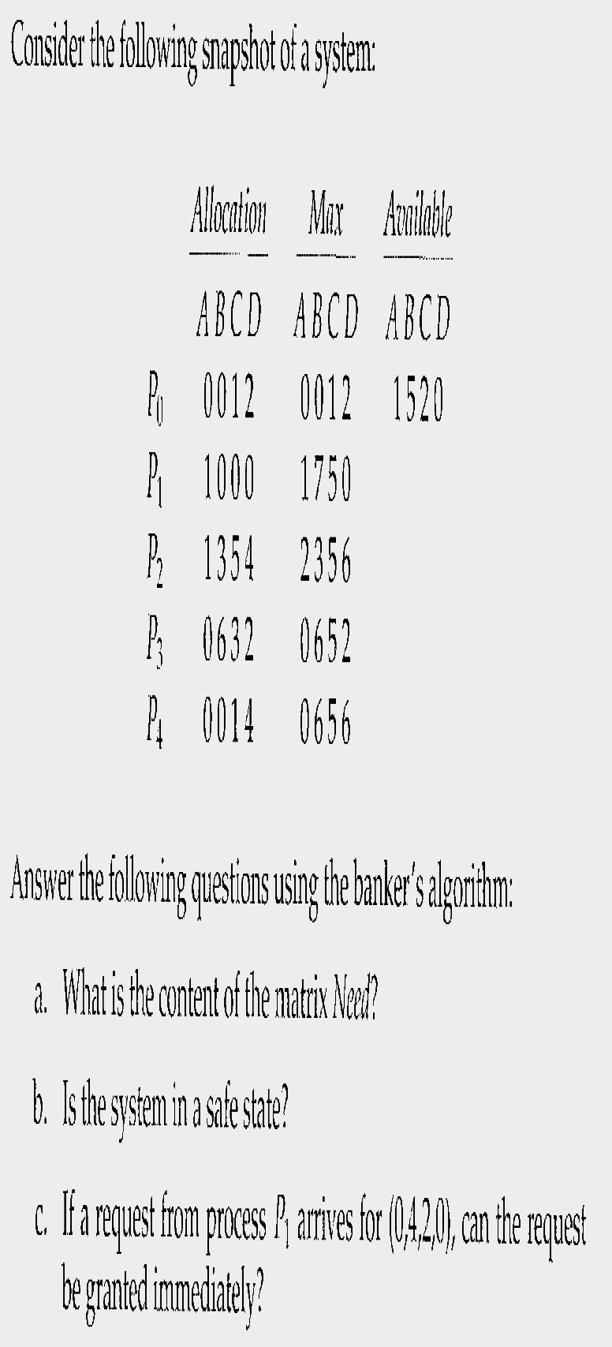
Operating System Concepts

Slide 52
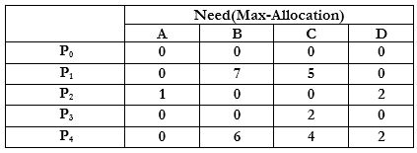
Operating System Concepts

Slide 53
Available=[1520]+[0012]=[1532]Available=[1520]+[0012]=[1532]
Need(P2) ≤ Available →→Available=[1 5 3 2]+[1 3 5 4]=[2 8 8 6]
Need(P3) ≤ Available→→ Available=[ 2 8 8 6 ]+[ 0 6 3 2 ]=[2 14 11 8 ]
Need(P4) ≤ Available→→Available=[ 2 14 11 8 ]+[0 0 1 4 ]=[ 2 14 12 12 ]
Need(P1) ≤ Available→→Available=[ 2 14 12 12 ]+[ 1 0 0 0 ]=[ 3 14 12 12]
Safe Sequence is <p0,p2,p3,p4,p1>
Operating System Concepts

Slide 54
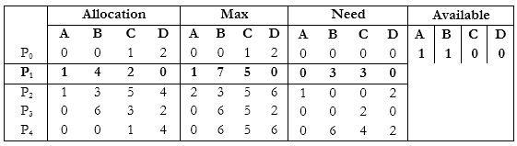
A request from process P1 arrives for (0,4,2,0)
Operating System Concepts

